Slide 1
UNIT
DAY 3
01
COUNTING IN TWOS
GAMES OF LOGIC
AGENDA
REMINDERS
Put your phones into The Holding Cell
Put your computers away, you won’t be needing them until the end
Warm Up Question
Why Two States?
Count to 31 on One Hand
Conversions
Fixed Width & Overflow
OVERFLOW demo
Mechanic Bank

Slide 2
THE WARM UP QUESTION
Think of the most recent board game you’ve played outside of class. Identify its main mechanic and its theme.

Slide 3
THE WARM UP ANSWER
Name a board or card game you’ve played more than ten times. In one sentence, what kept you coming back. Was it the theme or the rules?

Slide 4
WHY TWO STATES?
Bit – Binary Digit
Bits are physical
They represent voltage – high or low
A switch, open or closed
Conceptually, bits represent on/off, True/False, or 1/0
We use two states because that system is cheap, fast, and hard to misread
It’s very easy to see if a light is on or off, but much harder to see which of 10 dimness settings the light is on
(Light demonstration)

Slide 5
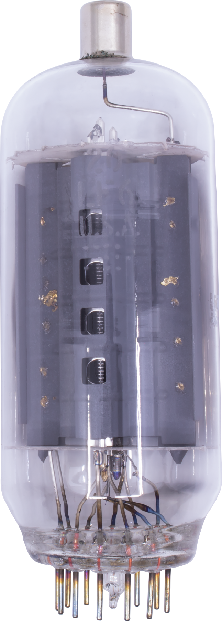
WHY TWO STATES?
Before we had digital transistors to store bits, we stored them using these vacuum tubes that would light up when storing a 1, or be off when storing a 0!

Slide 6
PLACE VALUES
Let’s look at a numerical system we already understand, which is called decimal
2048 = (2 * 1000) + (0 * 100) + (4 * 10) + (8 * 1)
Place Value | 1000 | 100 | 10 | 1
Digit | 2 | 0 | 4 | 8
Value | 2000 | 0 | 40 | 8

Slide 7
PLACE VALUES
How do we determine each place value?
Place Value | 1000 | 100 | 10 | 1
Digit | 2 | 0 | 4 | 8
Value | 2000 | 0 | 40 | 8

Slide 8
PLACE VALUES
Each place value is 10^{n}, where n is the number of the digit from right to left, starting at 0
Place Value | 1000 | 100 | 10 | 1
Digit | 2 | 0 | 4 | 8
Value | 2000 | 0 | 40 | 8

Slide 9
PLACE VALUES
So, if we had a system with 2 digits instead of 10, how would we calculate our place values?

Slide 10
PLACE VALUES
Binary numbers are calculated with each place being 2^{n}, where n is the number of the digit from right to left
So, from the left you’ll see 1, 2, 4, 8, 16, 32, so on and so forth, compared to 1, 10, 100, 1000…

Slide 11
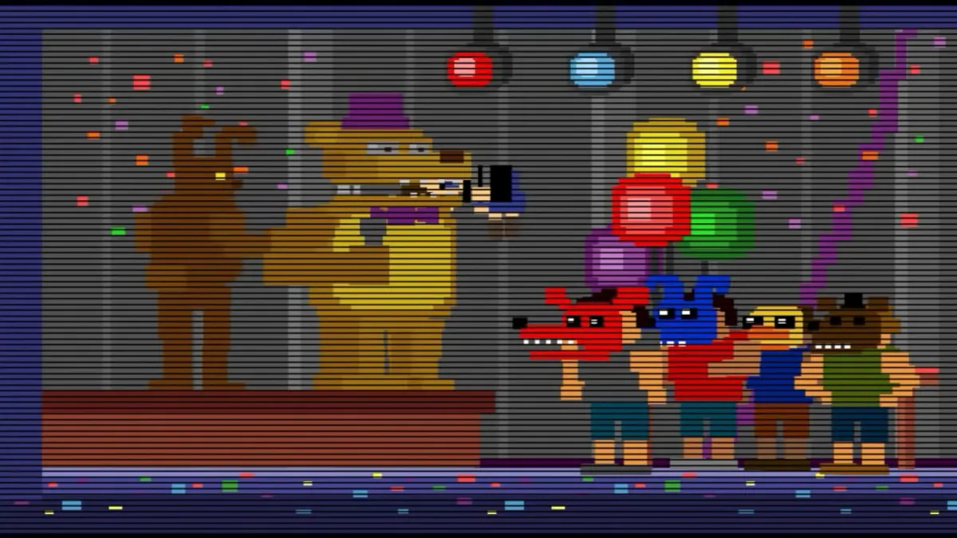
QUICK VOCABULARY
Binary digit – bit – one digit
Nibble – sequence of four bits
Byte – sequence of 8 bits
Most Significant Bit – the leftmost bit
It is most significant because it comprises the largest part of the completed number
Least Significant Bit – the rightmost bit
Least significant because it makes up the smallest part of the completed number
Determines if a number is even or odd
The byte of 87 would be 01010111

Slide 12
COUNT TO 31 ON ONE HAND
Your thumb is the 1, your index is the 2, your middle is the 4, your ring is the 8, and your pinky is the 16
What’s the most significant bit?
What’s the least significant bit?
Display the number 1
Display the number 4
Display the number 7
Display the number 13
Display the number 31
Display the number 30
How many bits are these numbers?

Slide 13
BINARY TO DECIMAL
Cool, now let’s do a binary number setup instead
101101 = (32 * 1) + (16 * 0) + (8 * 1) + (4 * 1) + (2 * 0) + (1 * 1) = 45
Any questions or confusion?
Place Value | 32 | 16 | 8 | 4 | 2 | 1
Digit | 1 | 0 | 1 | 1 | 0 | 1
Value | 32 | 0 | 8 | 4 | 0 | 1

Slide 14
BINARY TO DECIMAL
Now, let’s go the other way and convert the decimal number 77 to binary
What’s the largest 2^{n} number that will fit into 77?
Place Value | 128 | 64 | 32 | 16 | 8 | 4 | 2 | 1
Digit | ? | ? | ? | ? | ? | ? | ? | ?
Value

Slide 15
BINARY TO DECIMAL
Yes, 64 is the largest, and that leaves us with a 1 in the 64 slot, and a remainder of 13
We’ll put a 1 in the 64 digit slot, and a 0 in anything before that
Then, what’s the next largest power that will fit inside of 13?
Place Value | 128 | 64 | 32 | 16 | 8 | 4 | 2 | 1
Digit | 0 | 1 | ? | ? | ? | ? | ? | ?
Value

Slide 16
BINARY TO DECIMAL
8 is the next largest 2^{n} number that will fit, so let’s put a 1 there, and zeroes in everything before it left blank
Our remainder is now 5
Place Value | 128 | 64 | 32 | 16 | 8 | 4 | 2 | 1
Digit | 0 | 1 | 0 | 0 | 1 | ? | ? | ?
Value

Slide 17
BINARY TO DECIMAL
The process repeats, leaving us to see that 4 goes into 5, leaving a remainder of 1
1 goes into 1, leaving a remainder of 0, and a 0 in the 2 place
Then, we can fact check by adding 64 + 8 + 4 + 1 to see if those values are correct
Place Value | 128 | 64 | 32 | 16 | 8 | 4 | 2 | 1
Digit | 0 | 1 | 0 | 0 | 1 | 1 | 0 | 1
Value | 0 | 64 | 0 | 0 | 8 | 4 | 0 | 1

Slide 18
QUICK MATHS
Convert the following numbers:
Binary to Decimal:
1110
10101
11111111
Decimal to Binary:
6
23
200

Slide 19
HOW BIG CAN IT GET?
How large can a 4 bit number be?
How about an 8 bit number?

Slide 20
HOW BIG CAN IT GET?
If we do this for every number, we see the largest possible value a binary number can represent is
2^{n} – 1, where n is the number of binary digits possible

Slide 21
HOW BIG CAN IT GET?
So, what happens if I try to add 1 to 11111111?
There isn’t a place for it to go to
Any ideas?

Slide 22
HOW BIG CAN IT GET?
Unless we have a system that can make larger bit numbers, an overflow occurs
The number wraps back around to 00000000 instead of increasing
If a 9th bit was added, the number would be 100000000
So the bits at the end are just the 8 smallest bits of this number

Slide 23
REAL EXAMPLES OF OVERFLOW
Pac-Man - Perfect Game 3,333,360 – timestamp 5:20:00
(73) 15 Arcade Kill Screens – YouTube – timestamp 0:40

Slide 24
REAL EXAMPLES OF OVERFLOW
In these instances, the size of an 8-bit number is 255, so getting to stage 256 overflows the value to 0, a value that the game doesn’t understand
It will often glitch out, or create an unplayable level

Slide 25
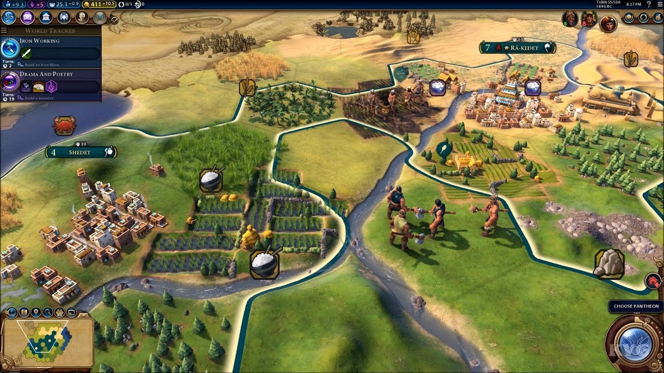
REAL EXAMPLES OF OVERFLOW
Has anybody played a Civilization game before?

Slide 26
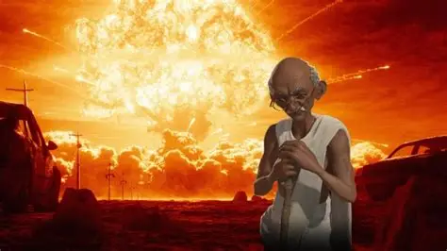
REAL EXAMPLES OF OVERFLOW
In Civilization 1, there’s a rumor that Gandhi’s behavior of using nuclear weapons was an integer underflow glitch with the game’s aggression value, but this is now debunked
why he using nukes then

Slide 27
HEXADECIMAL: THE PROBLEM
11111111 – this value is 255
It is correct, but very difficult to read
Takes up a lot of space, lots of repeating 1s
We need something shorter that still represents the bits

Slide 28
HEXADECIMAL: BASE 16
Enter hexadecimal:
If binary is base 2, and decimal is base 10, hexadecimal is base 16
But if it’s base 16, and we only have 10 digits, how do we do this?!
Hexadecimal digits: 0, 1, 2, 3, 4, 5, 6, 7, 8, 9, A, B, C, D, E, F
See! 16 “Digits”
What value of n makes 2^{n} = 16?

Slide 29
HEXADECIMAL: BASE 16
This means that one hex digit directly maps to 4 bits – one nibble of data
So, 11111111 = 255
We break this down into two sets of 4: 1111 and 1111, both 15
15 corresponds to F
So, in hexadecimal, 11111111 = 255 = FF

Slide 30
HEXADECIMAL: BASE 16
Convert 10110101 to decimal and hexadecimal (a.k.a hex)
Convert 00001111 to decimal and hex

Slide 31
YOU’VE SEEN THIS BEFORE
I can guarantee that each of you have seen hexadecimal before – anyone want to guess how?

Slide 32
YOU’VE SEEN THIS BEFORE
#FF0000 – the color
This is three bytes, the first byte represents red, the next byte being green, and the third byte being blue
So, what would this color be?
Color Picker – HTML Color Codes

Slide 33
YOU’VE SEEN THIS BEFORE
Give me the hex color code for purple
Then, give me the hex color code for white
What about black?

Slide 34
DEMO: OVERFLOW
Let’s have you guys try out my W.I.P. game based on this concept: Overflow
This is a rough prototype: tell me what’s wrong or what I need to improve it

Slide 35
DEMO: OVERFLOW
This game’s mechanic is inherently tied to the computer science binary concept
If you remove the ceiling of 31, it’s just addition
The bit width adds tension, and isn’t arbitrary
Because there is chance of a player drawing a perfect 31, there’s a different distribution than in typical Blackjack

Slide 36
MECHANIC BANK
Create a Google Doc called ‘Mechanic Bank’
Log two mechanics for games that could be based on topics from this lesson – in any way you can manifest them
Recall what a mechanic is and isn’t:
Not a mechanic: players collect cards worth 1, 2, 4, 8 – these are just components that could be reskinned
Mechanic: players push their card total as high as they can, but overflowing busts your hand, wrapping you to 0

Slide 37
LAB GRADE
Your lab for today, which will be your homework if you don’t have time to finish it, is ICA 1-2 – Number Conversions Lab, you can find it on the GitHub!

Slide 38
CLOSING
Next time:
We can now write any number a machine may hold. Turns out that text, images, and sound are all numbers too…

